Slide 1

SMART INDIA HACKATHON 2026
TITLE PAGE
Problem Statement ID –
Problem Statement Title-
Theme-
PS Category- Software/Hardware
Team ID-
Team Name (Registered on portal)

Slide 2
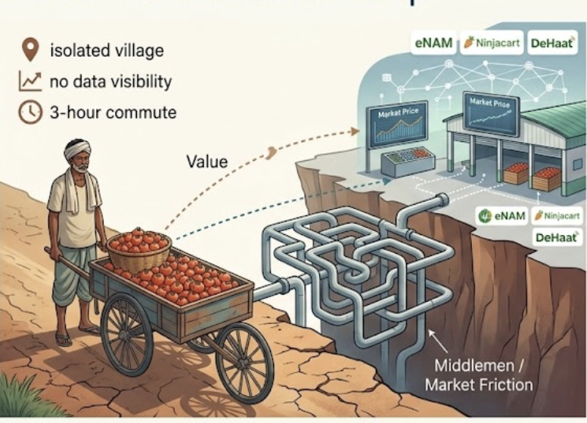
FarmLink
The Problem & The Gap
• A tomato farmer in a small village spends three hours just to reach the nearest mandi
• No phone app tells him what his produce is worth before he harvests
• By the time he finds out market prices, half his tomatoes are already spoiling in the sun
• 30 to 60 percent of what the consumer pays never reaches the farmer — it vanishes through layers of middlemen
• eNAM, Ninjacart, and DeHaat are real platforms with real scale
• But none of them reach Sampadrao's village — they're built for traders near cities, not for smallholders in remote blocks
• Farmers need WhatsApp, not another heavy app that crashes on patchy data connections
• Individual smallholders can't command marketable volumes without pooling through FPOs
• The digital agriculture revolution has left the smallest producers exactly where they were
@SIH Idea submission- Template

Slide 3
Our Solution & Its Uniqueness
FarmLink
Feature | eNAM | Ninjacat/DeHaat | Farmlink
FPO aggregation | ✗ | ✗ | ✓
WhatsApp-native access | ✗ | ✗ | ✓
Pre-sale price forecast | ✗ | ✗ | ✓
Perishability-weighted routing | ✗ | ✗ | ✓
Reaches remote smallholders | ✗ | ✗ | ✓
Real-time mandi prices | ✓ | ✗ | ✓
• Farmlink is a hyperlocal marketplace that aggregates FPO produce and connects farmers directly with bulk buyers
• We forecast demand and route pickups based on how quickly each crop spoils
• Farmers already use WhatsApp — we meet them there, no new app to download or learn
• We don't compete on scale — we serve the district-level farmers that national platforms structurally cannot reach
• eNAM works for traders at mandis, Ninjacart serves urban-adjacent farmers — Sampadrao is three hours from the nearest city
• Our routing optimizes for perishability first, not just shortest distance
• We're built around FPOs because aggregation is the only way smallholders get market power
• The platforms that exist weren't designed for people like Sampadrao — we were
@SIH Idea submission- Template

Slide 4
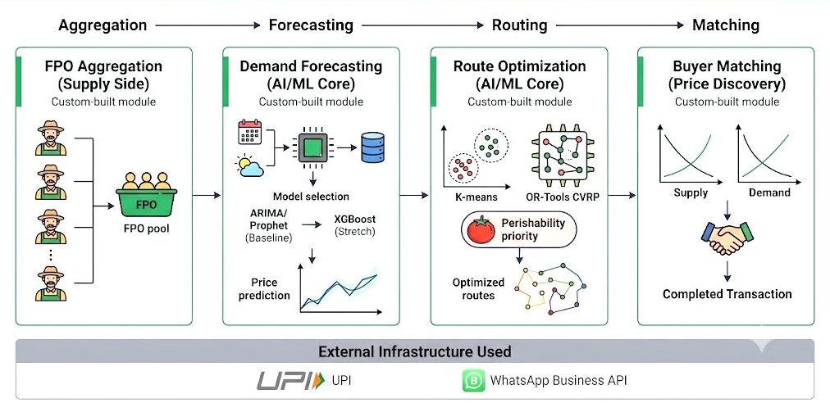
System Architecture
FarmLink
• FPO Aggregation pools individual farmers into marketable lots
• Demand Forecasting uses ARIMA and XGBoost on Agmarknet data to predict prices pre-harvest
• Route Optimization clusters pickup points and solves CVRP with perishability weighting
• Buyer Matching connects supply lots directly with bulk buyers
• WhatsApp Business API and UPI are external infrastructure — the four core modules are custom-built by our team
@SIH Idea submission- Template

Slide 5
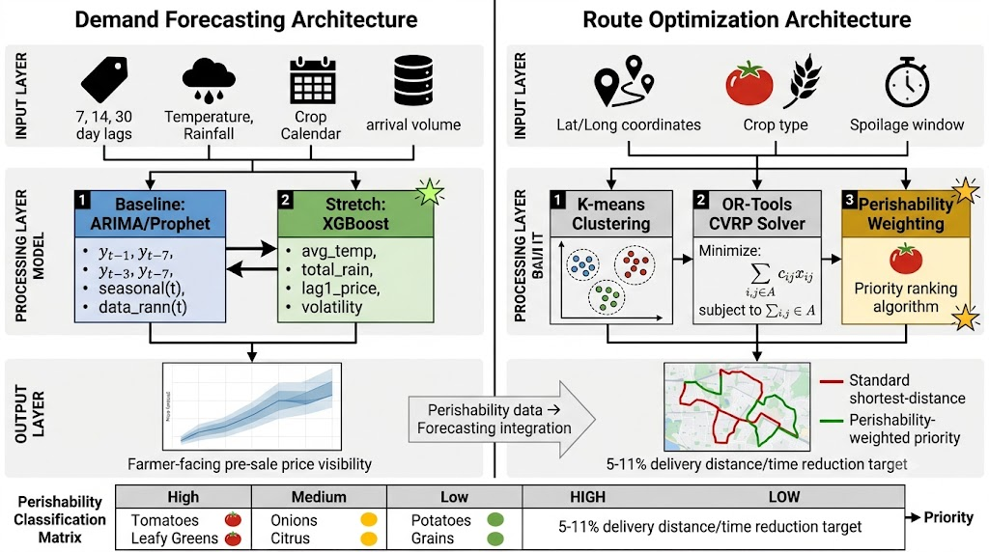
Core Technical Innovation
FarmLink
• Forecasting: ARIMA/Prophet baseline with XGBoost stretch using lag prices, weather, and arrival volume data
• Routing: K-means clustering with OR-Tools CVRP solver — our innovation is perishability-weighted objective function
• High-spoilage crops like tomatoes get pickup priority before potatoes and grains
• Target benchmark: 5–11% reduction in delivery distance and time
• This is a modified objective function on a well-studied technique, not a claimed invention
@SIH Idea submission- Template

Slide 6
Expected Outcomes & Impact
FarmLink
Expected Outcomes :
Farmer price realization: 15–20% reduction in intermediary share — from 60% loss toward 40%
• Routing efficiency: 5–11% reduction in delivery distance and time through perishability-weighted optimization
• Post-harvest loss: Perishable crops get picked up before non-perishable ones
• Better information means Sampadrao can decide when to sell instead of taking whatever the trader offers
• Faster pickup means his produce arrives fresher and commands better prices
• Aggregation through his FPO gives him bargaining power he never had as an individual
• We're not claiming he becomes rich overnight — each inefficiency gets chipped away systematically
Impact :
• Farmer income increases by 15-20% as intermediary layers get removed from the supply chain
• Sampadrao no longer spends three hours and precious diesel money traveling to a mandi with no price guarantee
• Pre-sale price forecasts mean farmers know what their crop is worth before they harvest — not after
• Perishability-weighted routing cuts delivery time by 5-11%, saving tomatoes and leafy greens from spoiling in transit
• FPO aggregation gives smallholders collective bargaining power they never had as individuals
• WhatsApp access means no app download, no data-heavy interface, and no digital literacy barrier
@SIH Idea submission- Template

